Slide 1









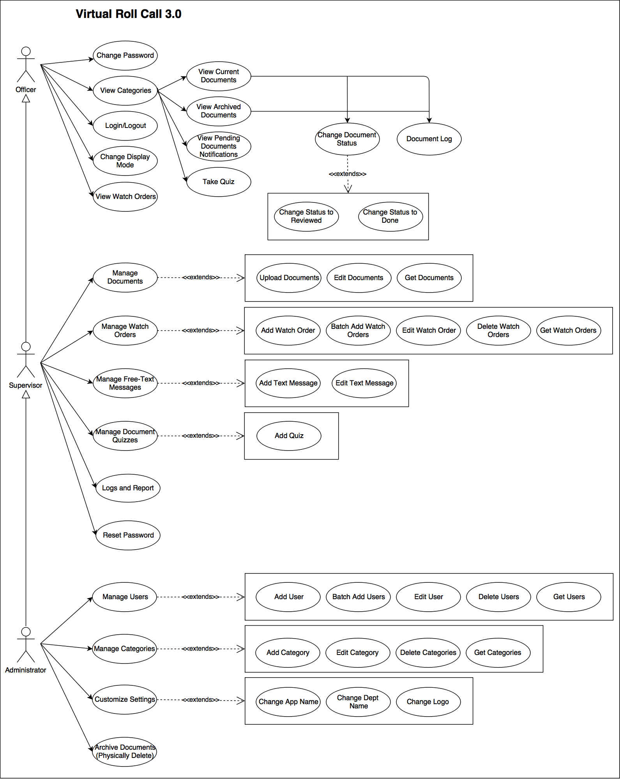
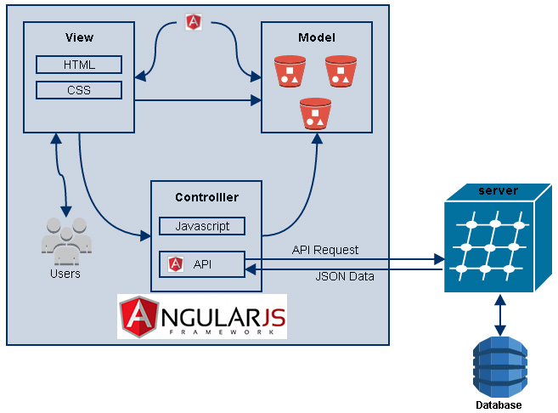
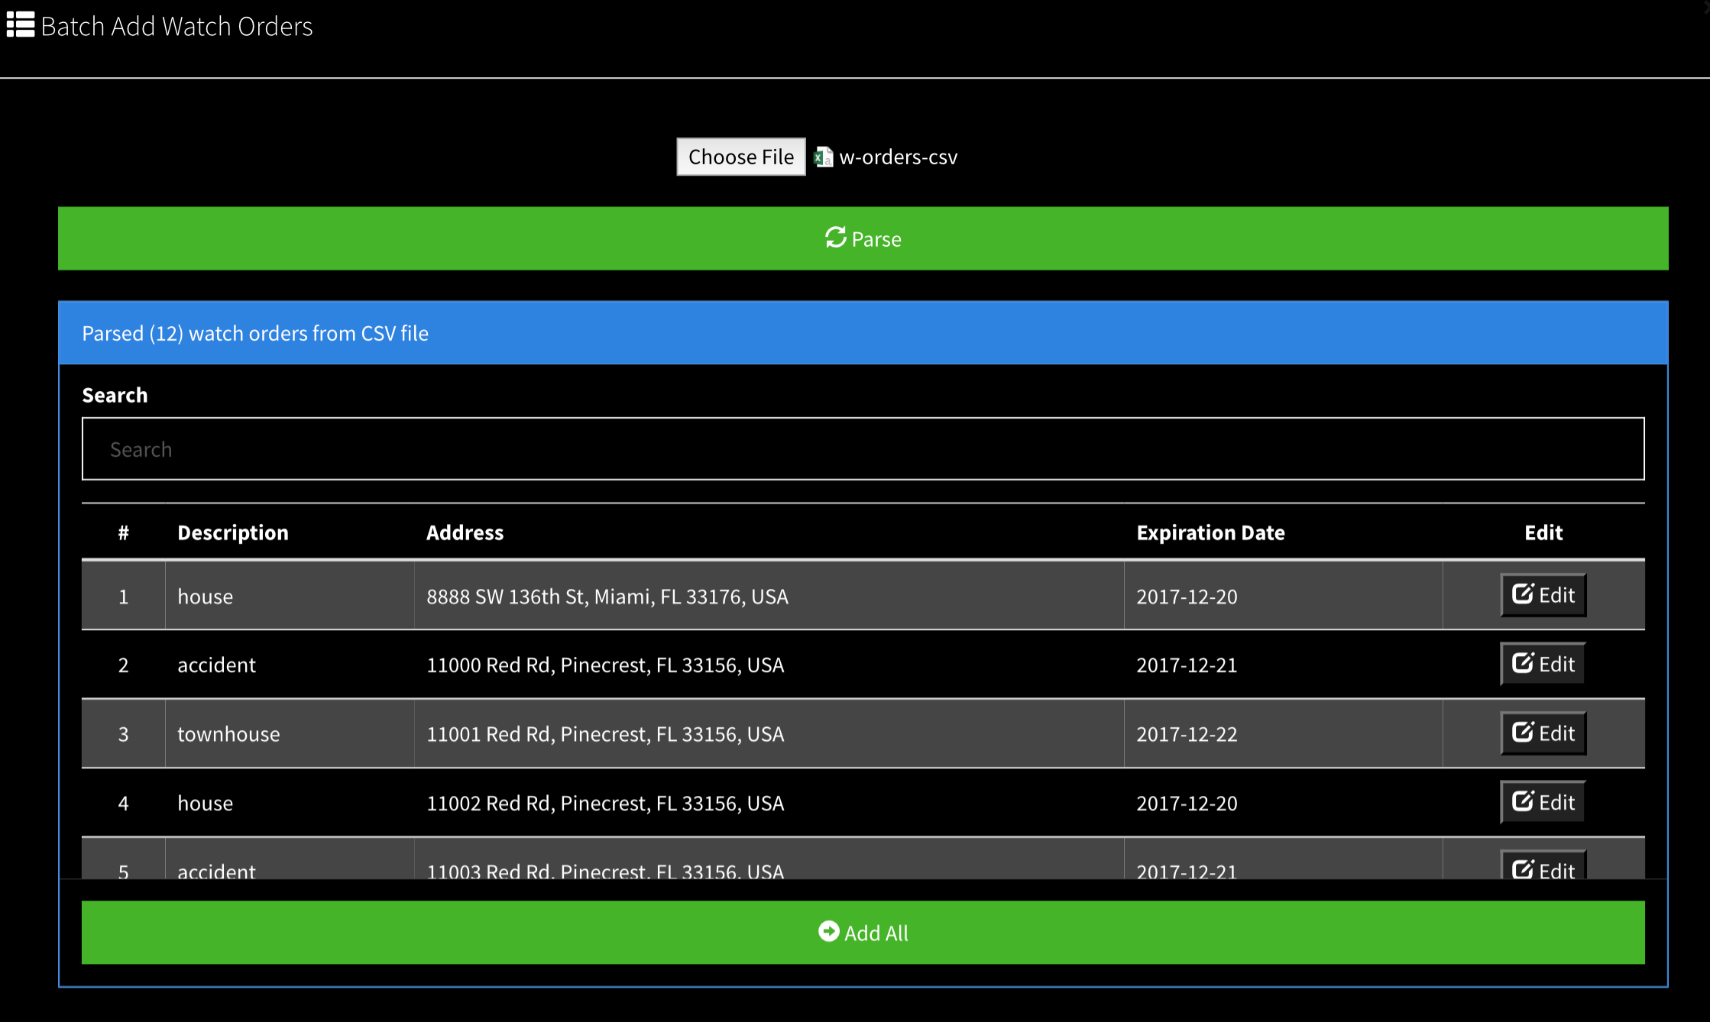
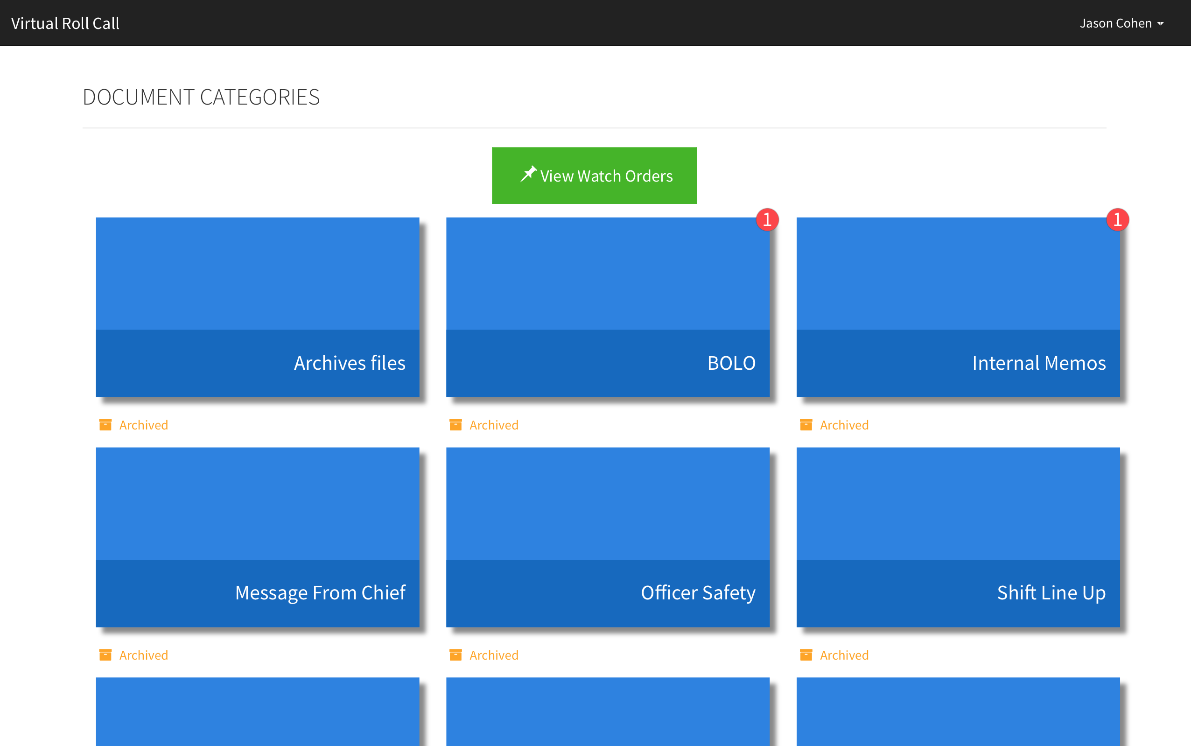
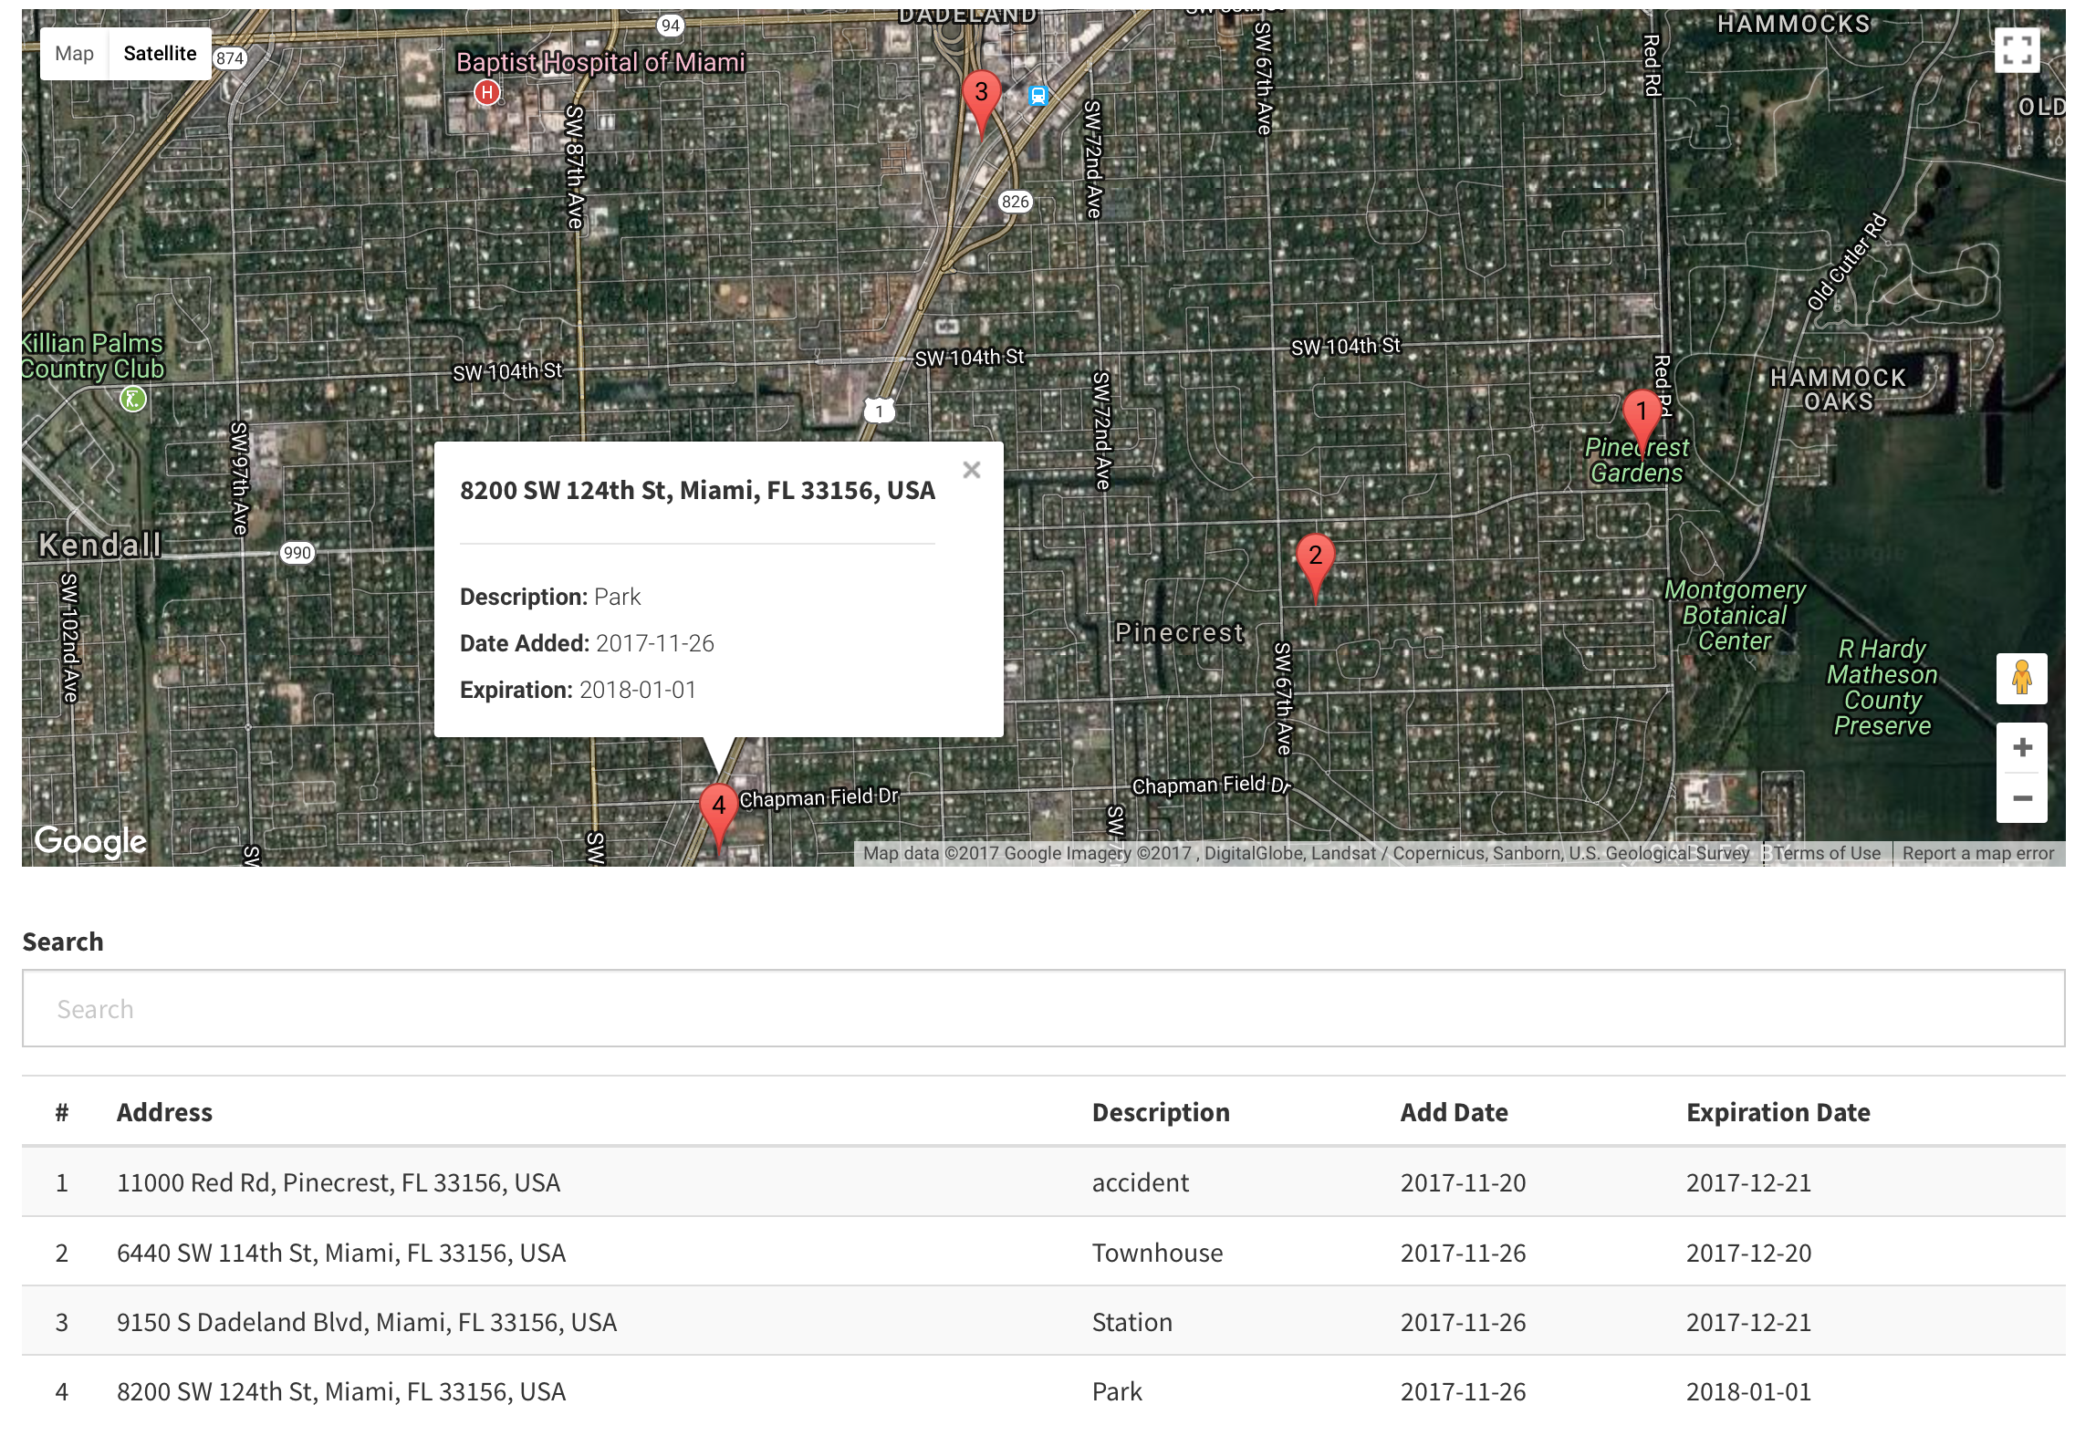
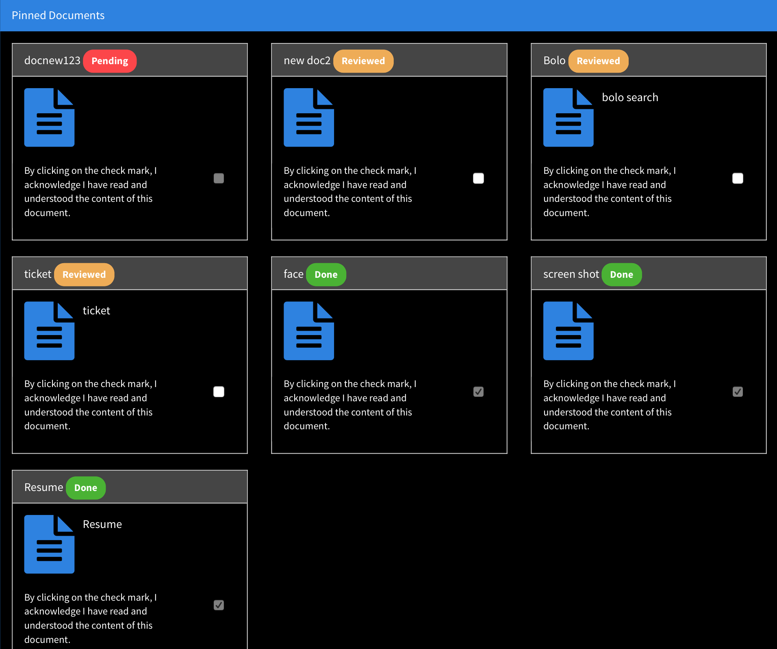
Virtual Roll Call 3.0
Senior Project, Fall 2017
Florida International University
Student: Juan Lopez
Mentor: Leila Zahedi
Instructor: Masoud Sadjadi
Problem
Implementation
Problem
Roll call is a briefing meeting in police departments where shift supervisors share critical information with officers.
Officers cannot always be present for these briefings, preventing them from receiving vital information.
It can be difficult for supervisors to distribute new material to officers after roll call is over.
The Virtual Roll Call (VRC) web application solves the following problems:
Eliminates the need for in person roll calls
Allows officers to receive information in real-time
Verifies that officers have reviewed required documents
Implementation
Frontend: HTML5, CSS3, Bootstrap, JavaScript, Angular JS
Backend: PHP
Database: MySQL
Web Server: Apache HTTP
Verification
Verification
Test Case | Story #242: Night Mode
Purpose | Verify that all UI elements on page are updated with corresponding colors and text for the current display mode.
Preconditions | User is logged in.
Input | User selects option to toggle display mode in navigation bar.
Expected Output | All UI elements on page will change when the display mode is modified: If night-mode is activated, all UI elements will have dark theme. If day-mode is activated, all UI elements will have light theme The text in the change-display-mode option is modified to include the previous display-mode: If night-mode is activated, option will read: “Change to Day-mode” If day-mode is activated, option will read: “Change to Night-mode”
Object Design
Object Design
Test Case | Story #246: Add Watch Orders with CSV File
Purpose | Verify that all valid watch orders from the CSV file are added to the watch-orders database table.
Preconditions | User is logged in and is in the batch add watch orders view.
Input | User selects a CSV file containing valid orders and selects the parse option. User selects the add-all option. User closes batch add watch orders view. User examines database, checking for new watch orders.
Expected Output | All watch orders will be removed from the parsed order table in the batch add watch orders view after the add-all option is clicked. All watch orders from the CSV file will be present in the watch-orders database table, indicating that they were successfully added.
Current System
Current System
Version 2.0 is currently in use by the Pinecrest Police Department. In Version 3.0, we focused on adding new features to enhance the usability and utility of the VRC app. My contributions to this third release include:
Ability to:
Add new users with a CSV file
Add a single watch order
Add a watch order list using a CSV file
Edit and delete existing watch orders
View watch orders using Google Maps
View watch order table list
Other Features:
Notification badge counter for pending documents
Improved document list presentation
Site-wide night mode
Automatic watch order deletion
Summary
System Design
Enhanced application visual design
Added ability to add users and watch orders with a CSV file
Improved application security
Added ability to view and manage watch orders
Created application distribution package
Added ability to view and manage text information
Added ability to create and take document quizzes
Requirements
Requirements
Change Display Mode
Display Documents within Application
Display Pending Documents Notification
Lock Users After Unsuccessful Login Attempts
Add Users with CSV File
Add Password Encryption
Improve Document List Presentation
Add, Edit, and Delete Watch Orders
View Watch Orders on Map
Application Distribution Package
Change Navigation Bar Based on User Role
Add and Edit Text Information
Add Document Quiz
Automatically Delete Watch Orders
Display Watch Order List
The material presented in this poster is based upon the work supported by the Pinecrest Police Department. I am thankful for the help that I received from my group members: Jean Faustin,
Jason Cohen, and Frank Alvarado.
Notes:
1

